Slide 1
Thickshake Historical Image Classification System
Mark Shelton

Slide 2
Face Detection
Text Recognition
Subject Recognition
Landmark Recognition
Library
Image File
Image Processors
Parallel Store
Machine Learning Classifiers
Pawsey Supercomputing Centre
Storage Interface
Report Writer
Report / Dump
Other Systems
Library
MARC Record
MARC Reader
Relational Database
MARC Writer
Partial MARC Record
Library
Metadata Parsers
Geolocation
Date Extraction
Notes:
Overall architecture

Slide 3
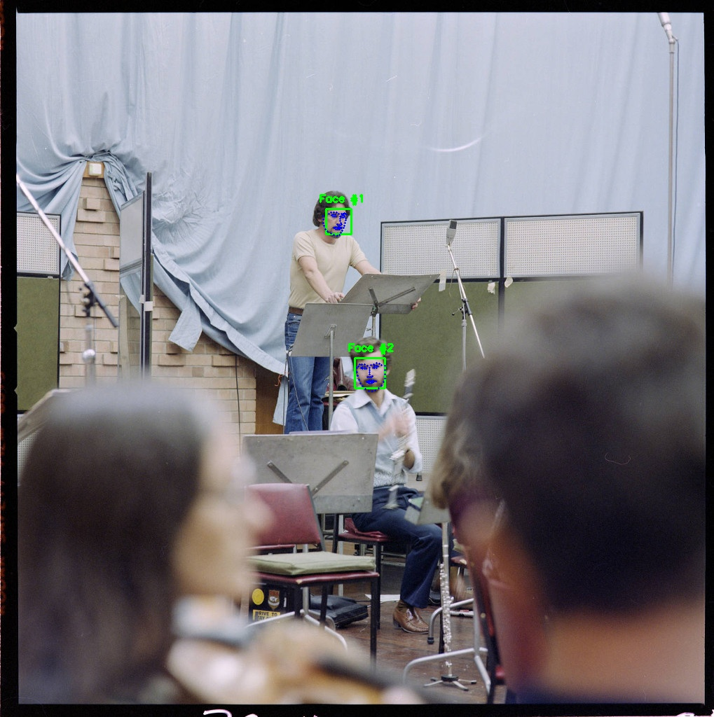
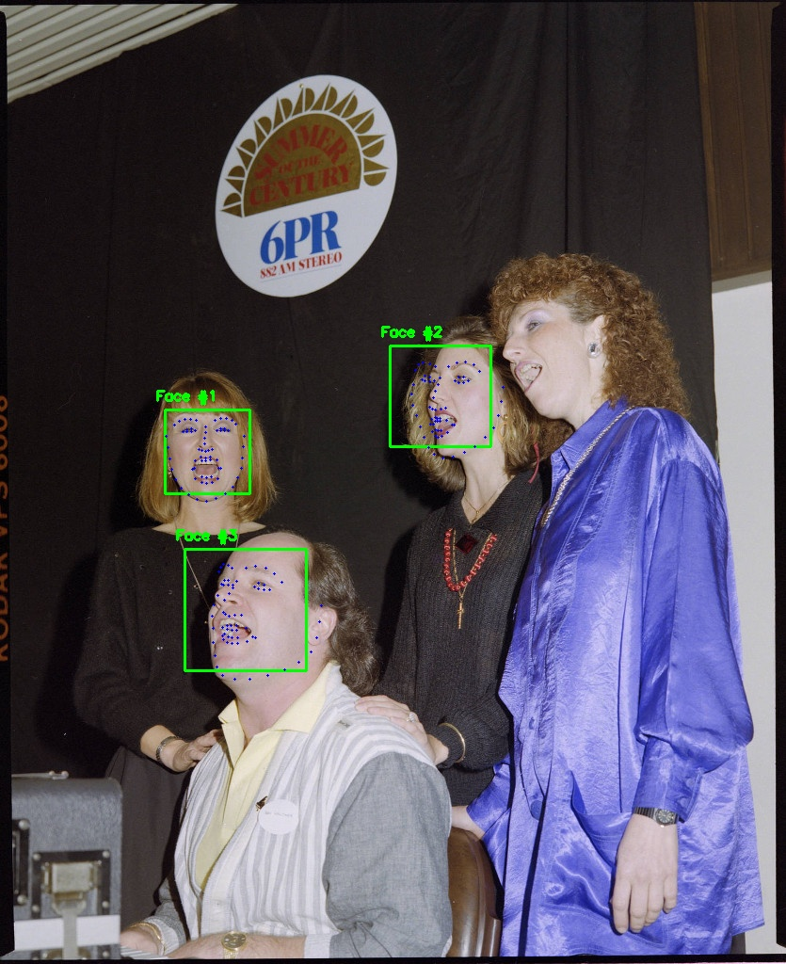
L: Detects principle subjects (at some distance)
R: Misses one principle subject because face is at too extreme an angle
Notes:
Convert Metadata format

Slide 4
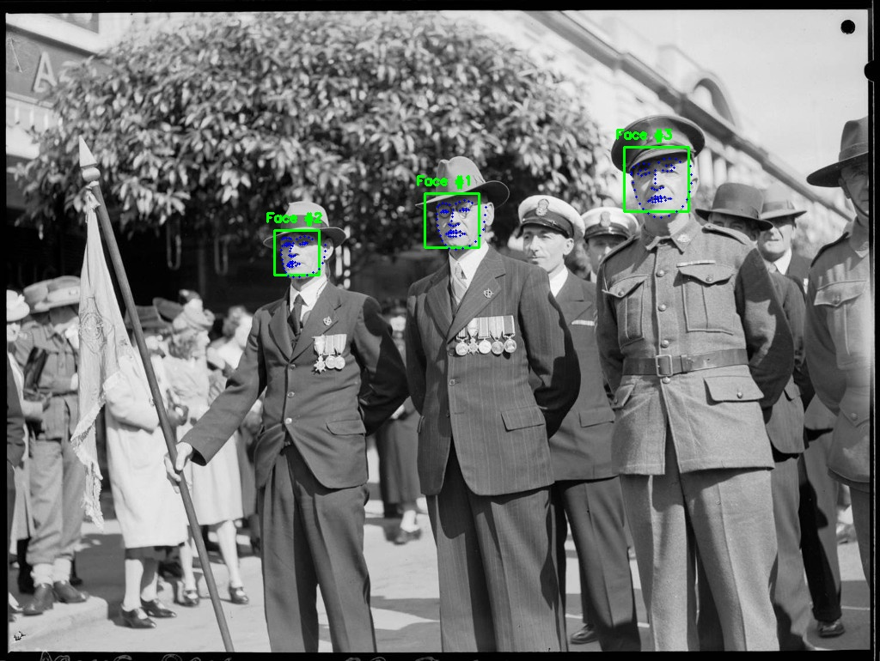
Detects principle subjects
Notes:
Face detection

Slide 5
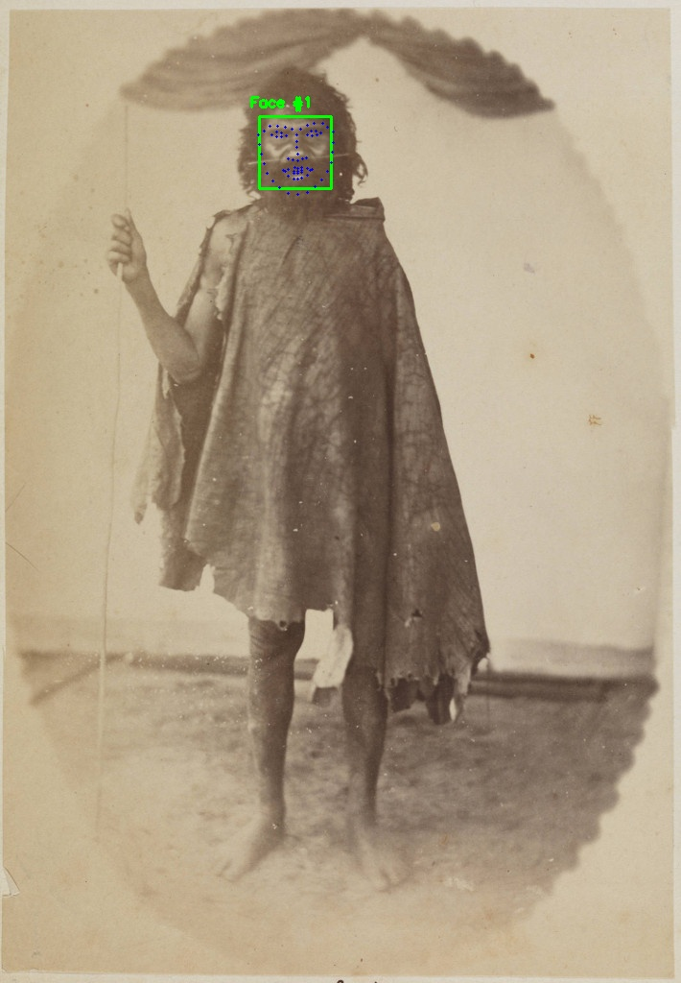
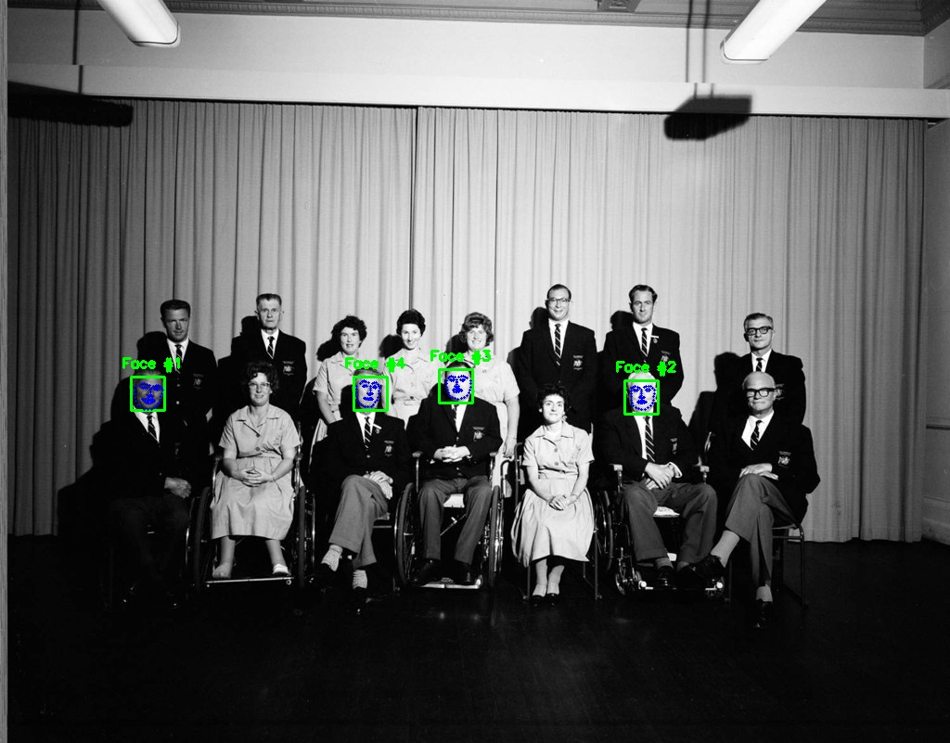
L: Detects face from old photo
R: Misses some faces because they are too small – will be addressed with larger images
Notes:
Face detection

Slide 6
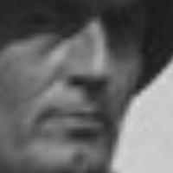
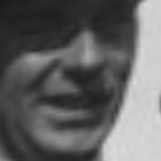
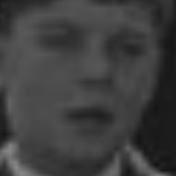
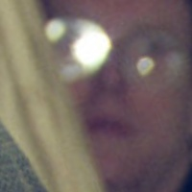
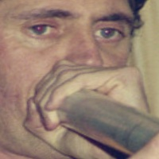
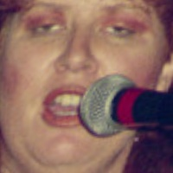
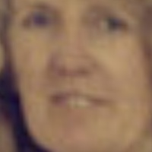
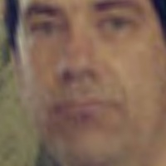
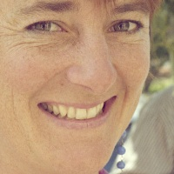
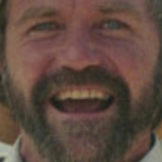
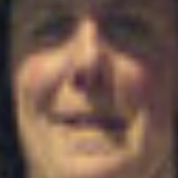
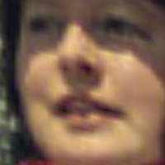
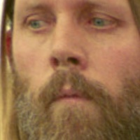
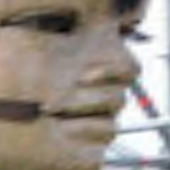
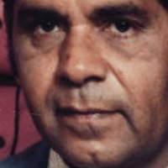
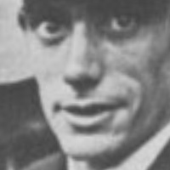
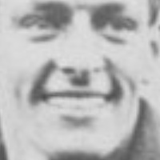

Photo distortion is caused by normalisation – all eyes and lips are moved to the same place.

Slide 7
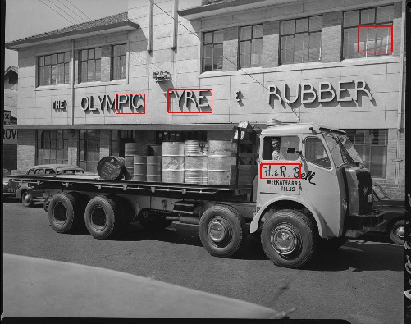
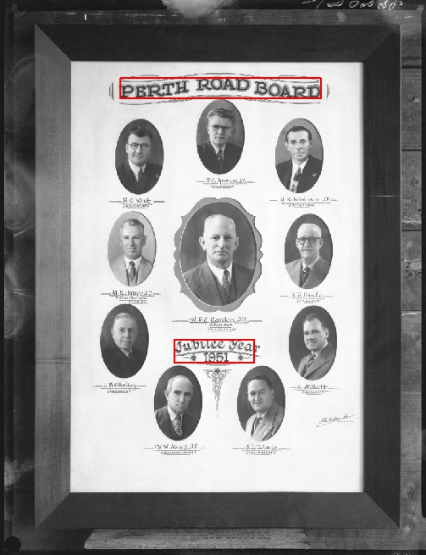
L: Has difficulty detecting low contrast text
R: Detects main headings, individual names are too small

Slide 8
Mappify API
2,500 request limit per day (free)
Based on PSMA G-NAF dataset
Image Title
Parsed Address
Geocoded Address
311688PD: Durham House building premises of Wrightson Dance Studios, The Inn Trim hairdressers, Galore House (no. 842) and Marjorie Young Antiques (no. 836) Hay Street, Perth, December 1982
building_name: None
street_number: ‘836-842’
street_name: 'Hay’
street_type: 'Street'
suburb: 'Perth’
state: 'WA'
location_type: ‘parsed’
building_name: None
street_number: '838-842’
street_name: 'Hay’
street_type: 'Street'
suburb: 'Perth’
post_code: '6000’
state: 'WA'
longitude: 115.85448
latitude: -31.95236,
confidence: 0.05,
location_type: 'geocoded’

Slide 9
Thank you …
Joshua Hollick (Curtin HIVE, Lead Supervisor)
Andrew Woods (Curtin HIVE, Supervisor)
Debra Jones (SLWA, Supervisor)
Sussanah Soon (Curtin HIVE, Collaborator)
Barbara Patison (SLWA, Advisor)
Adrian Bowen (SLWA, Advisor)
Catherine Kelso (SLWA, Advisor)
David Ong (SLWA, Advisor)
Maciej Cytowski (Pawsey, Advisor)

